Slide 1
Provost’s Report
Faculty Senate Meeting
Thursday, January 26, 2017

Slide 2
Agenda
Addressing budget issues impacting Academic Affairs
Percent of overall GRA budget going to departments and colleges – is it keeping up?
What’s happening to Miscellaneous Instruction budget?
What’s happening with start-up funds?
What’s happening with process of budget-reductions effecting Academic Affairs?
- Why was January 24 important?

Slide 3
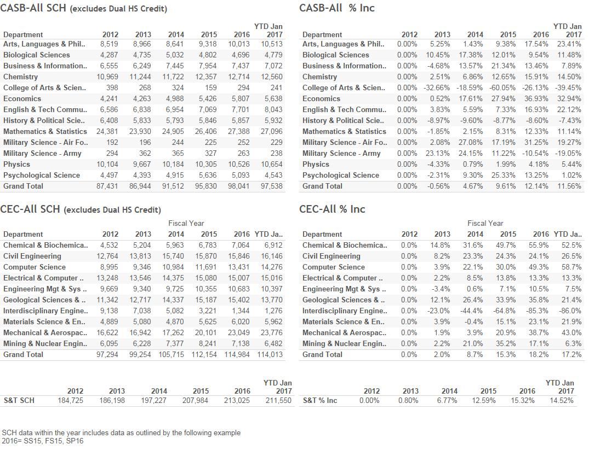

Slide 4
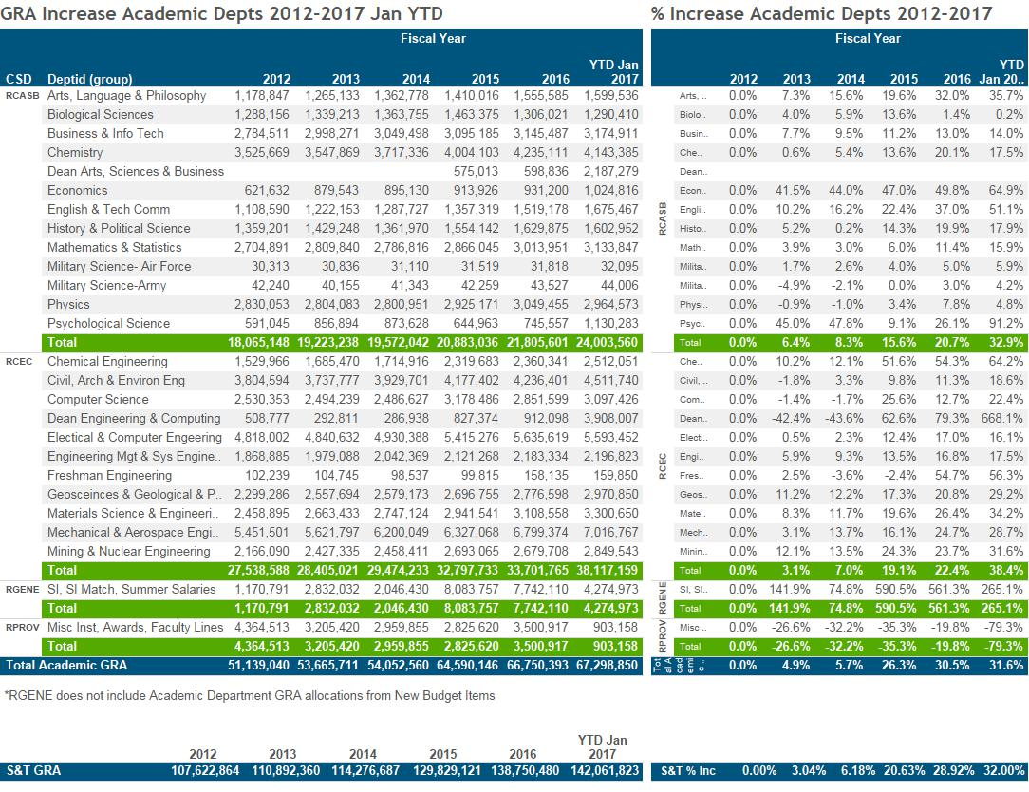

Slide 5
Concerns, continued
2) Miscellaneous Instruction
Rate sourced reductions between 2009-2011
Need backfilled by one-time (cost) dollars ever since
Those sources were transferred to Deans in Fall, 2016
Among our highest priorities to rebuild rate source for Miscellaneous Instruction going into FY18

Slide 6
Concerns, continued
3) Start-up Funding
Much the same story . . . source has been vacated positions, plus SI monies
Now transferred to Colleges as requested
But, SI has gone away
4) What is the process now?
What happened on January 24?

Slide 7
Division Updates
Faculty Senate Meeting
Thursday, January 26, 2017

Slide 8
Enrollment Management
Top 18 Missouri high school seniors selected on December 3 for Chancellor’s Scholarship.
44% female
78% are engineering (82% for total FTC group)
4.30 average GPA
35 average ACT (4 with perfect 36)
Monday, February 20 is Open House.
First freshman PRO registration day for Fall 2017 is Saturday, February 25.
VEX Robotics State Championship is Saturday, February 18

Slide 9
College of Arts, Sciences, and Business
Nicholas Leventis (Chemistry) has been awarded an additional $35,268 by the Army Research Office for his project entitled, “Fractal Assembly of Polymeric Nanoparticles into Fibers versus Globules: an Experimental and Computational Study” to bring the total award to $331,268.
Audra Merfeld-Langston (Arts, Languages, and Philosophy) has been awarded $93,229 by the U.S. Dept. of Education for her project entitled, “Developing a Minor in Latin American Studies for Technical Application.”
Manashi Nath’s (Chemistry) graphic abstract was published on the cover of the journal Chem Sus Chem issue 22. Her paper was also published in this journal.
Fiona Nah (Business and Information Technology) was named one of the “top women in VP” by the Girls in Tech website

Slide 10
College of Arts, Sciences, and Business
Petra Dewitt’s (History and Political Science) peer-reviewed article entitled, “Keeping the Cause Alive: Gottlieb A. Hoehn and the Socialist Party of St. Louis” was published in volume 50 of the Yearbook of German-American Studies. This volume also includes three book reviews she authored.
UM Research Board Awards:
Garry Grubbs (Chemistry) has been awarded $28,000 for his project entitled, “Structural Investigations of Noble Metal Clusters.”
Jeff Schramm (History and Political Science) has been awarded $16,016 for his project entitled, “History of the United States Bureau of Mines.”
Xiaoming He (Mathematics and Statistics) has been awarded $11,200 for his project entitled, “Modeling, Numeral Methods, and Data Assimilation for Coupling Dual Porosity Flow with Free Flow.”

Slide 11
College of Engineering and Computing
Xiaoping Du named Curators Teaching Professor for Mechanical and Aerospace Engineering
EMSE won 3 out of 4 competitions at the ASEM
Delbert Day elected to National Academy of Inventors
S&T named US Department of Transportation Tier 1 UTC. Partners with regional UTC with Nebraska and 2 others, headed by Genda Chen.
Bill Fahrenholtz named editor in chief of Journal of American Ceramics Society
Dr. Kamal Khayat will be honored with the ACI Foundation’s Jean-Claude Roumain Innovation in Concrete Award in March 2017

Slide 12
College of Engineering and Computing
Several outstanding educators recognized by Provost
Many thanks to CArE and other departments who have offered up space for those displaced from ECE
Muthanna Al-Dahhan named Curators’ Distinguished Professor of chemical and biochemical engineering and of nuclear engineering
Dr. Francisca Oboh-Ikuenobe was one of two invited speakers featured at the Women in Geosciences and Engineering forum during the 34th annual meeting of the Nigerian Association of Petroleum Explorationist

Slide 13
Office of Undergraduate Studies
Building Functional Teams in the Classroom and Beyond Workshop
Liz Hughes, principal consultant held a 5-hour workshop on January 12, 2017
Discussion was “The Five Dysfunctions of a Team” written by Patrick Lencioni
45 faculty and staff attended
Opportunities for Undergraduate Research Program (OURE)
Applications are open and will close on March 1st
Undergraduate Research Conference
Applications are open and will close on March 7th
Conference will be held on April 11th at the Havener Center
Undergraduate Research Day at the Capitol
1 day event on April 4th
10 Missouri S&T will be participating

Slide 14
Office of Graduate Studies
New Doctoral Recruitment Programs
Chancellor’s Distinguished Fellowship (CDF) http://grad.mst.edu/futurestudents/funding/cd_fellowship/
CDF seeks to recognize and recruit outstanding and exceptional new full-time domestic graduate students who will be pursuing a doctoral program at Missouri S&T. Eight new CDF awards will be given annually, up to four of which will be for underrepresented minorities and/or female students.
CDF Awardees will Receive:
$10,000 annual fellowship support for up to five years + 50% FTE appointment (provided by academic department) and tuition and supplemental fees remittance (provided by campus)
Dedicated fees support (informational technology fee, activity facility fee, health services fee)
Professional development opportunities
The Department Chair or Designee must submit the department nominations via this nomination form by Feb. 15, 2017. For more information on the nomination process and CDF policies, please visit the CDF webpage with associated FAQs

Slide 15
Office of Graduate Studies
New Doctoral Recruitment Programs
Campus Visit Programs:
Experience S&T Program http://grad.mst.edu/futurestudents/funding/experience_st/
This 1-2 day campus visit includes lab tours, campus tours, faculty meetings, and graduate student meet and greets. Reimbursement for travel will be based on the state of the student’s current institution.
VIP Experience S&T Program http://grad.mst.edu/faculty/vipexperiencestprogram/
This all-expense-paid VIP visit program is for highly competitive domestic doctoral prospects that meet requirements for the Chancellor’s Distinguished Fellowship.
Doctoral Student Recruitment Grants http://grad.mst.edu/faculty/doctoralstudentrecruitmentgrants/
This grant program is designed to increase efforts at the departmental level in the recruitment of doctoral students. The grant will be broken into two distinct tracks:
Track I: Recruitment of highly competitive underrepresented minority doctoral students (African American, Hispanic, Native American, Pacific Islanders) and/or female doctoral students
Track II: General recruitment of highly competitive doctoral students
Any department with a doctoral degree offering can apply. Applications must be electronically submitted by Jan. 25, 2017.
For more information, please visit the Doctoral Student Recruitment Grants webpage which includes associated FAQs.

Slide 16
Office of Graduate Studies
Recent Programs
New Graduate Student Orientation
Planned for day-long event on Friday, 1/13/17; rescheduled to Wednesday night, 1/18/17 with compressed schedule
24 speakers from campus on a variety of topics:
Advising, funding, library resources, technical editing, COER, counseling, student health, Council of Graduate Students, IT, RSS IT, Ed Tech, Diversity and Inclusion, academic dishonesty, student grievances, GRA/GTA/GA responsibilities, Registrar, Tech Transfer, Plagiarism, Environmental Health and Safety, Campus Police
58 new graduate students in attendance
Thesis/Dissertation Boot Camp held 1/9-1/12 with 15 students in attendance
Meet the Editor seminar held 1/18 with 30 students in attendance
Fellows Poster Session scheduled for Monday, 2/27 in Havener Center
View all of our student events scheduled for this semester: http://grad.mst.edu/events/

Slide 17
Office of Sponsored Programs
Summary of FY17 activities year-to-date (November)
Number of funded proposals is down by 8% for a total of 134
Total dollars is $16M which is down by 7%
Number of new proposals submitted is up 13% for a total of 261
Total dollars is $69M which is up by 4%
Number of active awards is up by 3% at 608
Total expenditures is $18M which is up by 5%
Net grant and contract expenditures is $14M which is up by 6%
F&A recovered is $2.5M which is up by 7%

Slide 18
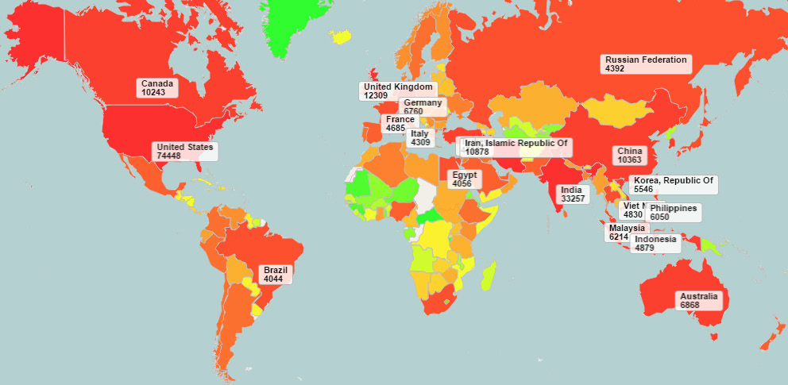
Curtis Laws Wilson Library
Scholars’ Mine Report, July 2016 – December 2016
Top 20 Countries by Downloads are Labeled
Total Downloads = 302,726
5% Increase over same time, 2015

